Slide 1
TPF C
DLM/DLL/SO Concepts
January 6, 2016

Slide 2
Agenda
DLM/DLL/SO
z/TPF Register, ECB & SW00SR
Stack Vs. Heap usage
Stubs
HLASM <-> C/C++ calls
DSECT <-> Header conversion
Directory in zTPFGI

Slide 3
DLM/DLL/SO
DLM - Dynamic load module
Compiled and linked source programs that are ready to be loaded in to main storage for execution.
Max size can be 16M.
Single entry point.
The name of a DLM entry point should match the 4 character DLM name or main.
A DLM transfers control back to its caller from its entry point function. Control can be given up either explicitly with a return or exit statement or implicitly when the last line of the function runs

Slide 4
DLM/DLL/SO
DLL - Dynamic Link Library
Dynamic link libraries
Collection of one or more functions.
Can contain multiple entry & exit points.
Programmer can choose the functions that needs to be exported for use by other DLLs or DLMs. This can be done using #pragma export function-name.
The #pragma export directive permits you to control specific functions and functions that can be exported when you can code this directive in your source file.

Slide 5
SO – Shared object
SO – Shared object
Shared Object is nothing but a z/TPF executable module, which can be packaged by using a variety of methods and programming languages collection of one or more functions.
In the z/TPF system, object files are included in a shared object, which is all or part of a computer program in a form suitable for loading into main storage for execution.
BAL shared object (BSO) is a type of shared object consisting of one or more objects that are created by assembling z/TPF E-type basic assembler language (BAL) programs.
C shared object (CSO) is a type of shared object consisting of one or more objects that are created by compiling C language programs or assembling z/TPF BAL programs using C/C++ calling conventions.

Slide 6
Make file
MakeFiles
Makefiles are used by the maketpf command to specify the program name, type, component, and any special build options that are required for a clean build (assemble, compile, and link).
Each makefile contains,
SO name (APP := ABCD )
Source File Variables(ASM_SRC, C_SRC, CXX_SRC)
Linked Libraries (LIBS := CDEF)
Maketpf Environment Variables

Slide 7
Stubs
Stubs
Stubs are used to resolve external references between BSOs
Generated using the stub generation tool from IBM
The BEGIN macro generates an external reference in the shared object that maps to the name of the entry point.
All stub entries for transfer vectors and multiple source BSOs are located in a IBM control file

Slide 8
z/TPF Registers , ECB & Sw00sr
z/TPF Registers & usage
TPF_REGS is the structure that defines the z/TPF registers.
The general-purpose registers should be avoided from being used as storage in C/C++.
But, assembler programs / assembler utilities may require values to be passed through registers.
One can declare variables of this data type and use the needed registers that are organized as members in the structure
TPF_REGS regs;
enq_parms.request_type = ELD_DEQ;
regs.r6 = (int)&(enq_parms);

Slide 9
Stack v/s Heap
Stack
Stacks are used to manage function environments represented by local variables and parameter lists.
Allocated from a contiguous virtual address space set aside for the stack
The first time a C/C++ function is called, an initial storage area (ISA) is set up to handle the C/C++ environment and control blocks.
Each frame holds space for information relevant to a given function (such as the automatic variables and a register save area). When the function returns, its frame is removed from the stack and the frame for its caller becomes the current frame

Slide 10
z/TPF Registers , ECB & Sw00sr
ECB & usage
Header file - C_EB0EB.H
For C/C++ programmers, the preferred purpose of the ECB work areas is to interface with assembler programs
Below is an example of ECB usage in programs
#include <c_eb0eb.h>
struct eb0eb *ecb;
char *Input;
ecb = ecbptr();
Input = ecbptr()->ce1cr0;

Slide 11
z/TPF Registers , ECB & Sw00sr
sw00sr & usage
Header file - C_SW00SR.H
dfifb , dfopn functions returns the address of SW00SR slot
Below is an example of SW00SR usage in programs
#include <c_sw00sr.h>
dft_fil *file_ptr;
ULONG PsgFileAddress;
UCHAR PsgFileRcc;
file_ptr = dfopn(PSG_FIL_REF,
PSG_FIL_FID,
DFOPN_NOHOLD);
PsgFileAddress = file_ptr->sw00fad;
PsgFileRcc = file_ptr->sw00wcc;

Slide 12
Stack v/s Heap
Heap
Applications can request contiguous storage from the ECB heap by issuing a calloc, malloc, realloc function
Use the free function to return the storage

Slide 13
HLASM -> C/C++ calls
C/C++ function can be called using ENTRC or CALLC macro
Call using Function name with CALLC
Setup parameters using CPROC macro
Include the CPROC statement in the UPROC macro;
Alternatively can code CPROC statement directly to the beginning of the assembler program which applies to all of the matching CALLC statements that follow.
CPROC RETURN=i,psgrVerifyUtility,(c,p,us)
GETCC D4,L2 Get a core block
L R5,CE1CR4 Copy address of core block
LA R7,PARM_AREA Get address of PARM_AREA in R3
CALLC RETURN=i,psgrVerifyUtility(pax_status,R5,(R3))
...
pax_status DC C'C' Character passed to C function

Slide 14
HLASM -> C/C++ calls
Call with DLM name as program name with ENTRC
Setup parameters as needed. Each parameter requires a full word
Make R1 point to the beginning of the parameter list.
R15 has the return value
Also can use Registers & ECB area to pass parameters
LA R1,100 LOAD HEAP SIZE
MALOC SIZE=R1 TO GET GROUP DONE COUNT
LA R14,6 SPECIFY ROUTINE 6 IN BJ01
ST R14,0(R1) BJ02_getIRSCTtodo()
ENTRC BJ01 CALL C/C++ DLM
STH R15,RCHICNT SAVE TOTAL COUNT

Slide 15
C/C++ calls -> HLASM
Calling HLASM program can be done using entrc() function
Alternatively can use the function name which can be resolved by #pragma directive
Parameters can be passed using the TPF_REGS structure
ECB areas can also be used to pass parameters/values
The return value of the function call should always be void.
TPF_REGS regs;
enq_parms.request_type = ELD_DEQ;
regs.r6 = (int)&(enq_parms);
clek_enq_deq( &regs );
ecbptr()->ebxsw0 = COL0_ENQ_NOT_HELD;
#pragma map(clek_enq_deq,"CLEK")

Slide 16
C/C++ calls -> C/C++ calls
Calling a C/C++ function present in a DLL/DLM from another C/C++ function.
Need to pass the parameters as required by the calling function. (Pass by value or pass by reference).
Expect the return values as specified in the function declaration. (Type casting might be needed in a few cases)
struct pgm_history_parms Elm_Parms;
memcpy (Elm_Parms.ph_loadset_name,
ELD_AVAIL_LSNAME,
sizeof (Elm_Parms.ph_loadset_name));
Elm_Parms.ph_pgm_base = parms_ptr->pgm_base;
elm_program_history (&Elm_Parms);

Slide 17
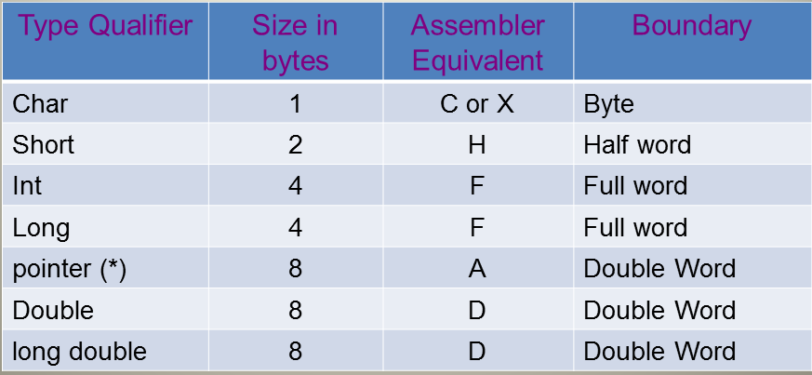
DSECT <-> Header conversion
Data types

Slide 18
DSECT <-> Header conversion
DSECTS are exhaustively used in TPF – Assembler programming.
Structures and Unions are the C counter parts of DSECTS.
A DSECT is converted into a header file. The naming convention is a c_xxxxx where xxxxx is the name of the DSECT.
In case of DSECTS, specifying an explicit length results in both the size of the object and it’s alignment to be modified.
In C, all the structures are unpacked by default. C supports a keyword _Packed to match with the assembler macro.
The usage of an org directive in DSECT can be substituted by using unions

Slide 19
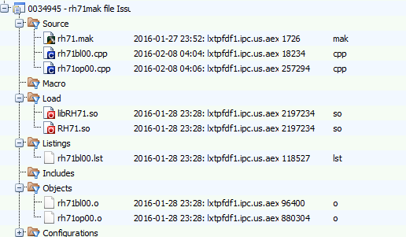
Directory

Slide 20
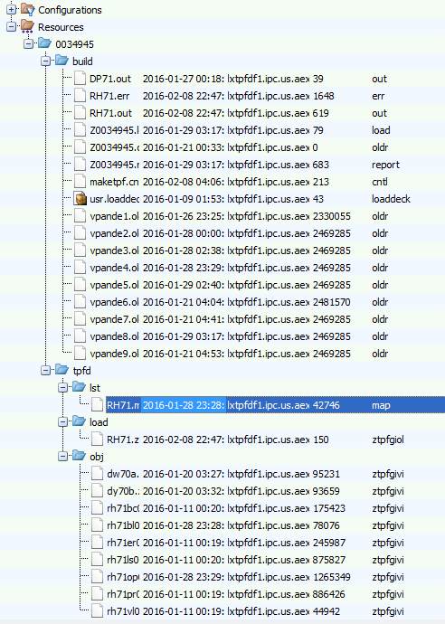
Directory

Slide 21
Thank You
Contact Info
Ved Pandey
vedprakash.pandey@tpfsoftware.com

